Slide 1

NYC Air Quality Analysis
Analyzing Pollution Trends, Comparisons, and Hotspots Using a Heatmap

Slide 2

Introduction
This presentation explores air pollution trends in NYC using an interactive heatmap.
The research aims to identify trends over time, compare pollutants, and determine the most polluted areas.

Slide 3
Data & Methodology
- The heatmap visualizes pollution intensity over different years and pollutants.
- PM 2.5 and NO2 levels are mapped for borough-wise comparison.
- Users can filter by pollutant and year to analyze trends.
- Markers provide specific values per borough for detailed comparison.

Slide 4
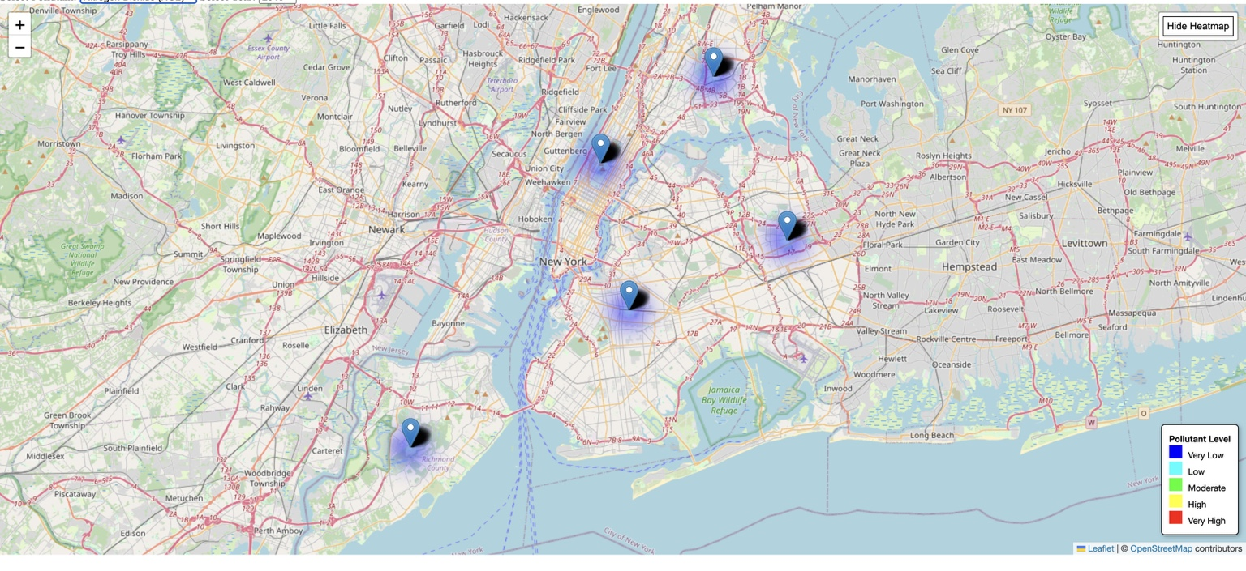
- The heatmap shows fluctuating pollution trends over the years.
- Manhattan and the Bronx consistently show higher pollution levels.
- Improvements are visible in some areas due to environmental regulations.
- Seasonal variations may influence pollution levels.

Slide 5

Comparison of Different Pollutants
- PM 2.5 is more widespread across NYC, impacting all boroughs.
- NO2 concentrations are highest in high-traffic areas like Midtown Manhattan.
- PM 2.5 affects respiratory and cardiovascular health.
- NO2 is linked to lung irritation and asthma, especially in urban zones.

Slide 6

Which Areas Experience the Highest Pollution?
- Manhattan and the Bronx show consistently high pollution levels.
- Queens and Brooklyn have moderate pollution with some hotspots.
- Staten Island generally has lower pollution levels.
- Areas near bridges, tunnels, and highways have higher NO2 concentrations.

Slide 7
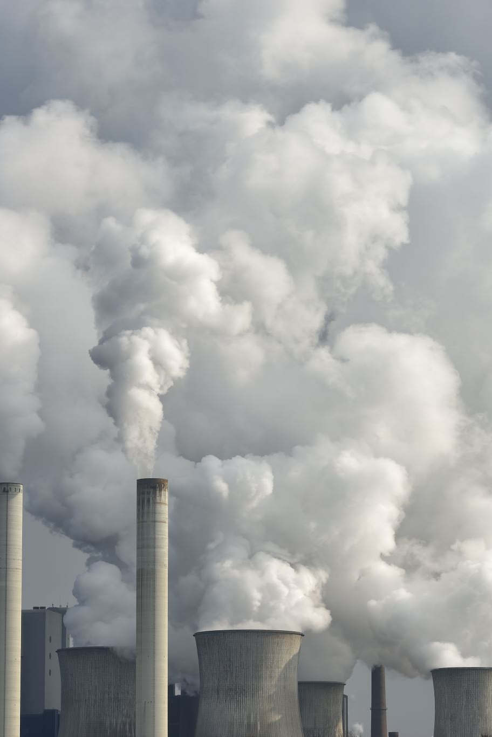
Conclusion & Recommendations
- Pollution trends vary by borough and pollutant type.
- Traffic and industrial zones are major contributors to high pollution levels.
- Some areas show improvement over time due to policy interventions.
- Future enhancements could integrate real-time data and predictive modeling.

